Slide 1
COMP407 Selected Topics II IT Solutions for Business 2014/15 1st semester
SugarCRM Improvement System
Team members: Athena HOI Ka Wai (P1104463)
Sandy CHEN Wan Ping (P1107936) Key LIANG Yi Juan (P1107923)
Supervisor: Dr. Benjiman Ng
Assessor: Dr. Rita Tse

Slide 2
Introduction
Overview of LTGame
EGM (Electronic Gaming Machine) manufacture in Macau
Live Multiple Games System (LMG)
Paradise Jackpot System
Issues in marketing, sales, customer service and technical service
The quantity of business with customers is increasing
A customer relationship management (CRM) system is need in emergency
Notes:
Consequently, a customer relationship management (CRM) system is of the greatest necessity and importance for the company. To meet their needs, SugarCRM is tried to be used in the company. However, some problems still occurs.

Slide 3
Background
Current CRM system — SugarCRM
open-source
charge for extra functions
flexible management system
perfect IT equipment management function
manage customer relationships systematically
Notes:
The Live Multiple Games machines include Live Baccarat, Live Roulette, Live Sicbo, Live Blackjack, Live SanGong and Live Keno.
The Paradise Jackpot is a patent granted Baccarat-based progressive jackpot.
For example, there are lots of after-sale services in the LT Game, CRM system could track every service until it solved.
SugarCRM systemcan enhance the competitiveness of the enterprise and service quality.

Slide 4
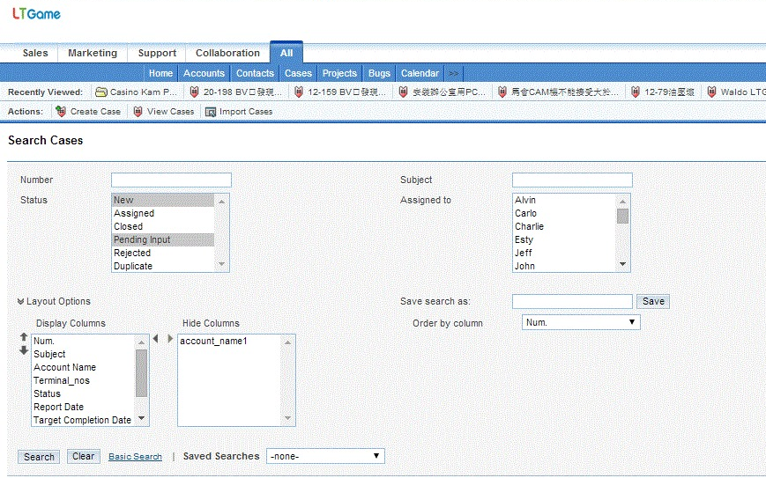
SugarCRM

Slide 5
Introduction
Objectives
Discover and understand the needs of the company LTGame through internship and interviews
Identify the potential weaknesses in their IT system
Identify the requirements of an improved CRM system
Develop an improved CRM system
Achieve a 90% staff utilization rate of using the improved CRM system

Slide 6
Methodology
Requirement Elicitation
Know more about the SugarCRM
Discover current issues
Gather requirement
Our solution
Observe user behaviors
Be one of the user
Discover issues from experiment

Slide 7
REQUIREMENT ELICITATION
Observation
Operation of different position
Project Manager
IT Manager
Technician
etc.
Scenario of operating
Initial new case
Operation
Activity
Lost report tracking
Report status update

Slide 8
REQUIREMENT ELICITATION
Problems Identification
Search engine
Interface
Import/export
No client-side server
No Report function

Slide 9
Requirement Specification
Functional requirements
User Registration
Case Operation
Searching case information
Importing Accounts
Importing Cases
View Accounts
View Cases
User Administration

Slide 10
Requirement Specification
NON-Functional requirements
Multi-language (Chinese and English)
24 hours available
Provide training course
25GB database storage
Target users: operators and floor managers
E-mail address as account name
Digital maintenance report
Report status checking with automatic warning email

Slide 11
Requirement Specification
Domain requirements
Run on windows os and mac os (the two most common platforms)
Online services only

Slide 12
System Implementation
Developing environment
Development tools: PhpStorm
Server: Apache
Database: MySQL

Slide 13
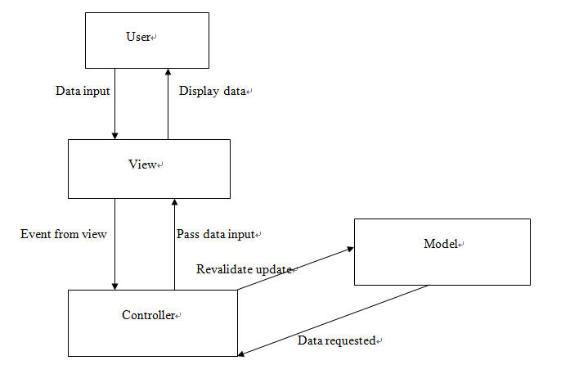
System Implementation
Architecture
The client-server web application follows MVC software design pattern.

Slide 14
System Implementation
Data Modeling - Identifying entity type
The following table shows the specific attributes of the classes in the function.
Entity name | Attributes | Description | Data type &length | Nulls | Multi-valued
Staff | Email | Uniquely identity email of staff in casinos | 30 variable characters | No | No
 | Name | The name of staff | 15 variable characters | No | No
 | Company | The company of the staff | 50 variable characters | No | No
 | Password | Password for user verification | 6-16 characters and both number and character are required | No | No
Case | Subject | The subject of the post | 30 variable characters | No | No
 | description | The description of the post | 200 variable characters | No | No
 | PostDate | The date the staff that post the problem | Date | No | No
 | status | The problem of posts’ status | 15 variable characters | No | No
Technician | Email | Uniquely identity email of operator | 30 variable characters
 | Name | The name of operator | 15 variable characters
 | Password | Password for operator verification | 6-16 characters and both number and character are required | No | No

Slide 15
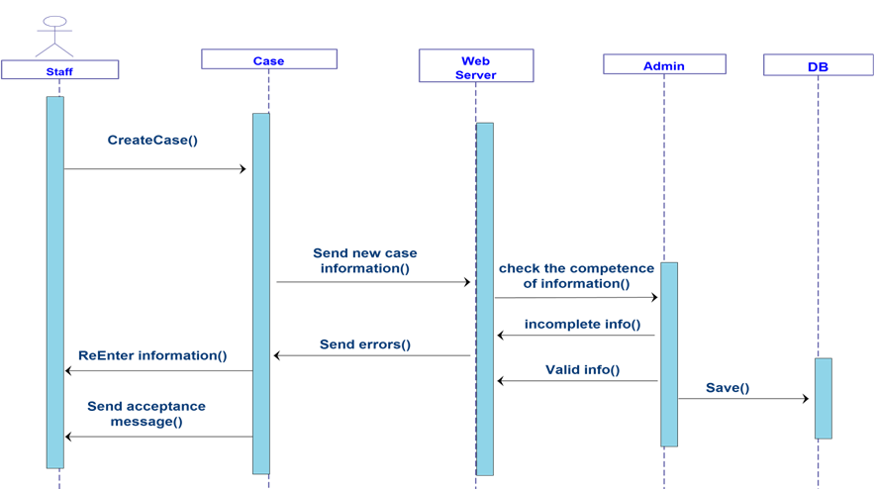
System Implementation
Data Modeling - sequence diagram
The following is the sequence diagram of staff in casinos creating a new case.

Slide 16
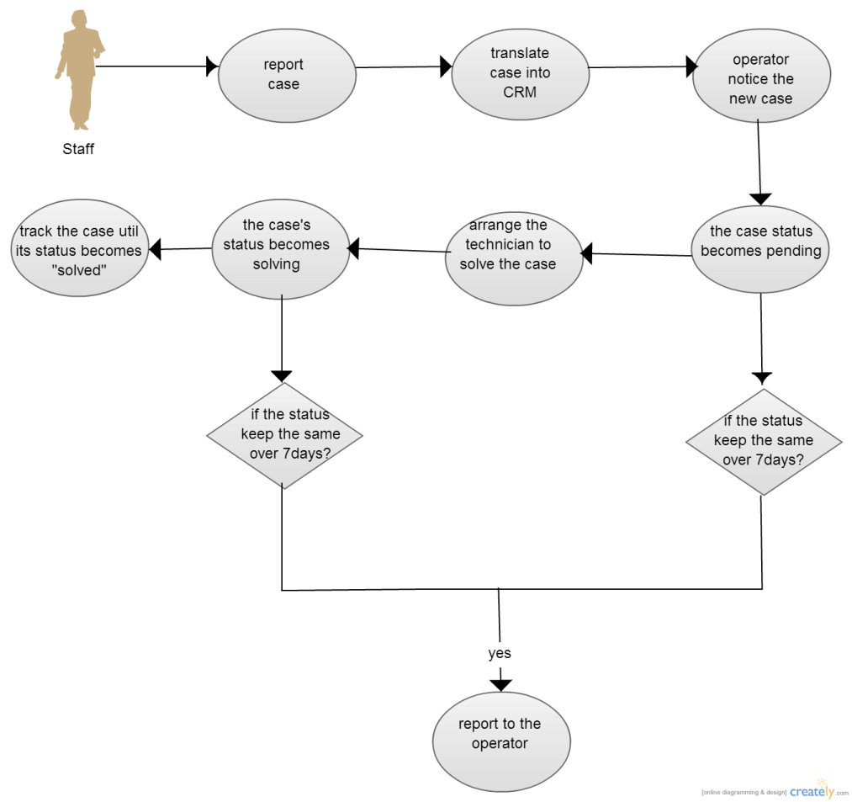
System Implementation
Data Modeling – create a new case
The following is flow chart which shows the progress of the function of creating new case.

Slide 17
System Implementation
Enhancement to existing system
Input report with a text box (instead of using the SugarCRM or Excel file)
Send notification E-mail once a case is reported
Automatic routine report checking
Notes:
This reduce the complex process of doing a report from the staff to the CRM system because what the staff need to do is type the same simple description into this application and send it out.
If an case is reported over 10 days but not yet closed, a warning e-mail will be sent to the managers and technicians who are related to the case.

Slide 18
System Implementation
Key problems and their solutions
Installation the system
Promoting the new CRM to casino manager and IT technician
(unwilling to learn a new system)
Managers are unwilling to have an extra training.
Notes:
The importance of using a new CRM is explained to them so that they would attend the training section and learn how to use it effectively.

Slide 19
Results
Project Outcomes
Casino floor manager
Report new cases
Check the status of the cases they create
Confirm the complete of the cases
LTGame Operator
Update the status of case
Create new account
View all the created accounts in group of casinos.
View all the reported cases
Search case
Sort search results by case name, status, subject, people to assign, account name, priority
Notes:
The importance of using a new CRM is explained to them so that they would attend the training section and learn how to use it effectively.

Slide 20
Conclusion
We have studied the main function of existing Sugar CRM in the LTGame company.
We have done the requirement analysis of CRM system.
Design a new proposed CRM to improve the original one.
Notes:
The importance of using a new CRM is explained to them so that they would attend the training section and learn how to use it effectively.

Slide 21
Q&A Thanks for your listening!

